Slide 1


Broker Architectural Pattern

Slide 2
Presented By
Hamza Mehmood Jibran Naeem Saad Rehman Anique Kahadim

Slide 3


Broker Pattern
An architectural pattern is a:
General, reusable solution to a commonly occurring problem.
Architectural patterns are similar to
Software design pattern but have a broader scope.
This pattern is used to:
Structure distributed systems with decoupled components.
A broker component is responsible for the
Coordination of communication among components.

Slide 4



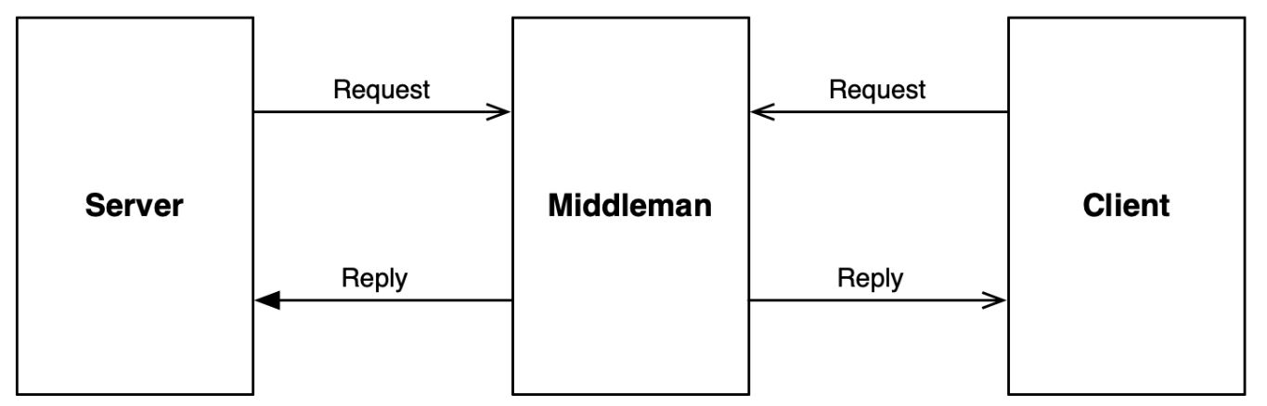
Understanding the broker Pattern
The broker architectural pattern is used to:
Architect distributed systems.
These systems make use of a:
Middleman component to coordinate and communicate between components.
This decoupling of components:
Removes dependencies and can result in greater system-wide efficiencies.

Slide 5
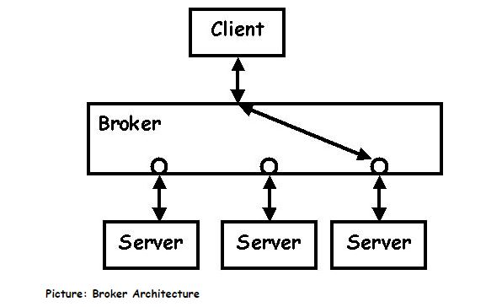
Used to structure distributed systems
Decouple components that interact by remote service invocations.
Responsible for coordinating communication.
Forwarding of requests from client to server.
Transmission of results and exceptions.

Slide 6

Pattern Characteristics
Building: A system as a set of decoupled interacting components gains in:
flexibility
mantainability
changeability
distributability
scalability
Distributed Components need inter-process communication:
Easier to build.
Can use same programming language.

Slide 7

How does it work?
At all times servers can register and deregister themselves with the broker. If a server fails, it will be automatically (after a timeout) unregistered by the broker.
The client requests a specific service. It formats its request in a specific format and sends it to its broker. The broker then selects the most suitable server to process the request. When the link between the client and the server is set up, they may start communicating directly, freeing the broker.

Slide 8


When should you use it?
Where does it come from?
You go to a broker to buy a house.
You don't want to need to know all about
the housing business, costs, quality,
suppliers.You just tell the broker your
maximum price and some other
Requirements and he starts looking.
If the relation client-server is not fixed because there are many suitable servers or the availability of the servers changes over time.
The choice of server depends on some criterion that is complex enough to be delegated to a separate component.
If you want to be independent of the physical location of the server (location transparacy).

Slide 9
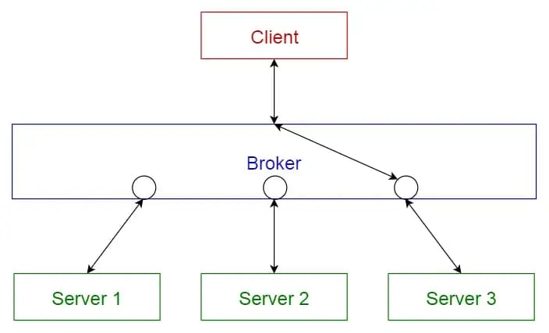
Main Components.
It has the following broad characteristics:
The main components of the broker architectural pattern are
Clients
Servers
Brokers
It also has bridges and proxies for clients and servers. Clients send requests, and the broker finds the right server to route the request to. It also sends the responses back to the clients.

Slide 10
APPLICATIONS
Broker is responsible for coordinating communication, such as forwarding and dispatching the results and exceptions. It can be either an invocation-oriented service, a document or message - oriented broker to which clients send a message.
It is responsible for brokering the service requests, locating a proper server, transmitting requests, and sending responses back to clients.
It retains the servers’ registration information including their functionality and services as well as location information.
It provides APIs for clients to request, servers to respond, registering or unregistering server components, transferring messages, and locating servers.

Slide 11
Advantages:
Disadvantages:
Resource sharing − Sharing of hardware and software resources.
Openness − Flexibility of using hardware and software of different vendors.
Concurrency − Concurrent processing to enhance performance.
Scalability − Increased throughput by adding new resources.
Fault tolerance − The ability to continue in operation after a fault has occurred.
Complexity − They are more complex than centralized systems.
Security − More susceptible to external attack.
Manageability − More effort required for system management.
Unpredictability − Unpredictable responses depending on the system organization and network load.

Slide 12
Centralized System vs Distributed System
Criteria | Centralized system | Distributed System
Economics | Low | High
Availability | Low | High
Complexity | Low | High
Consistency | Simple | High
Scalability | Poor | Good
Technology | Homogeneous | Heterogeneous
Security | High | Low

Slide 13
Known Uses:
CORBA - Common Object Request Broker Architecture
IBM SOM/DSOM
OLE/COM/DCOM/Active X
World Wide Web (WWW)
Variants:
Direct Communication Broker System
Broker manages the channels for communication,
Callback Broker System
There is not clear client or server differences. A event pops up and broker picks the right service(s) to react.

Slide 14
THANK YOU

